Slide 1
进度汇报
毛宽诚
2019/06/26

Slide 2
基于pytorch的单/双波段行人检测实验
训练集：train-all-02(set01-set05)
train-all-20(set01-set05)
测试集：test-all-20(set06-set11)
2252张图片。
标签：person/people/people?/cyclist
训练：全部训练/只取person
测试：忽略 people/people?/cyclist
忽略 occlusion/小尺寸
仅统计person
person 478 197 46 87 0 0 0 0 0 0 0
person? 39 130 83 249 0 0 0 0 0 0 0

Slide 3
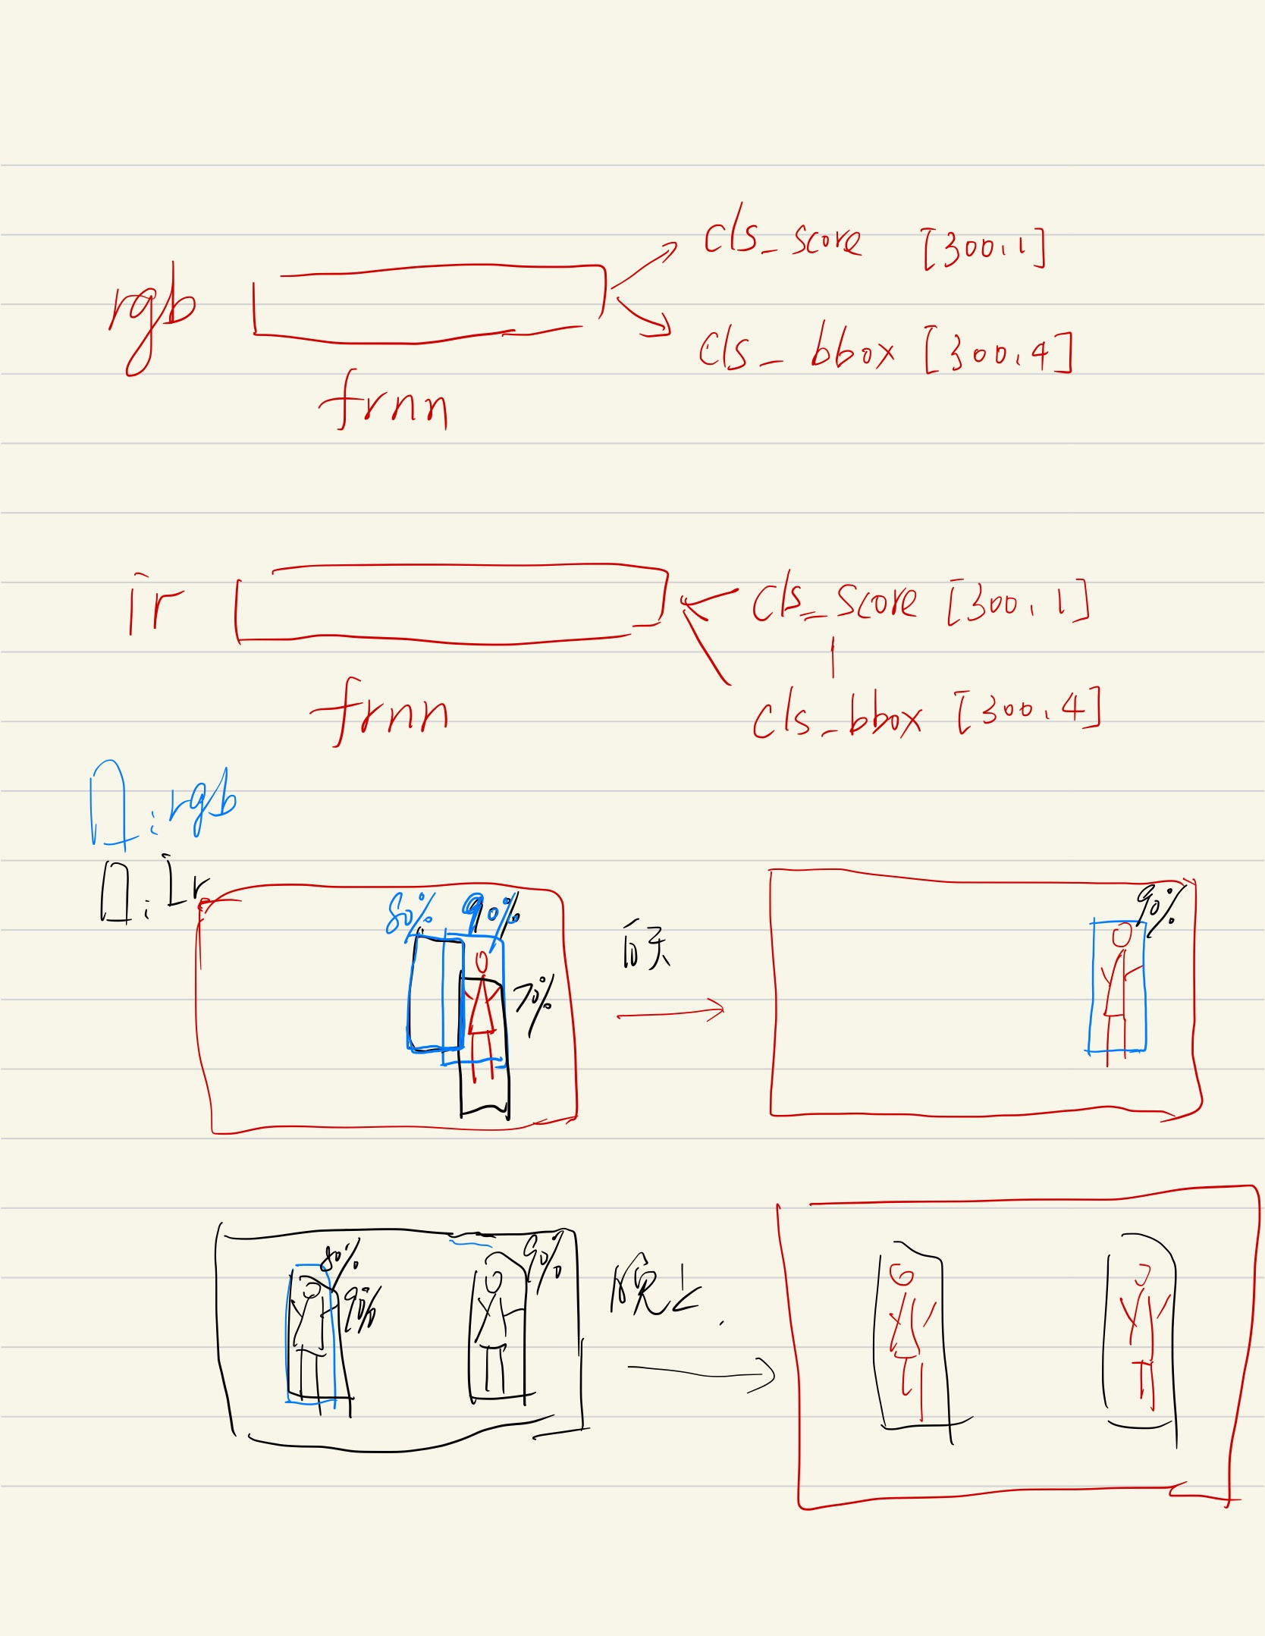
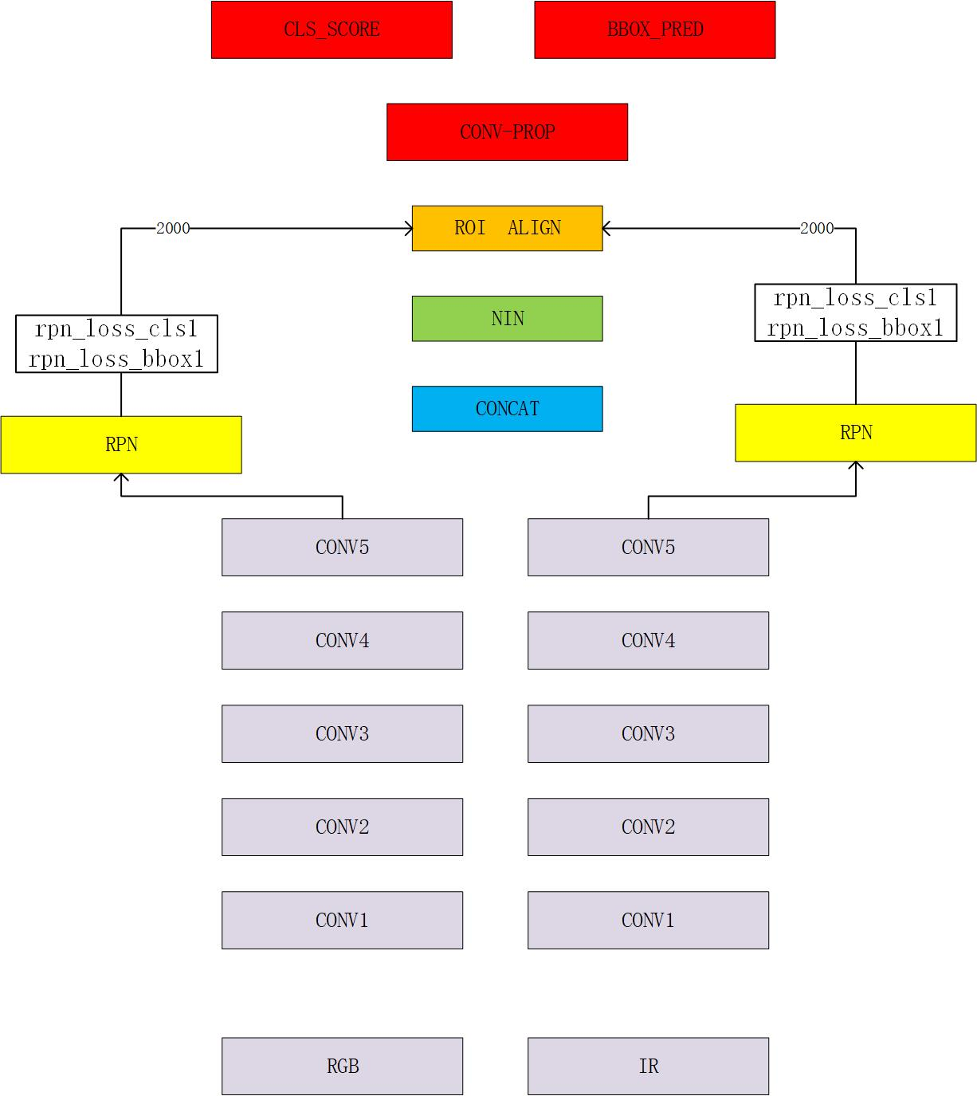
rpn fusion
nms fusion

Slide 4
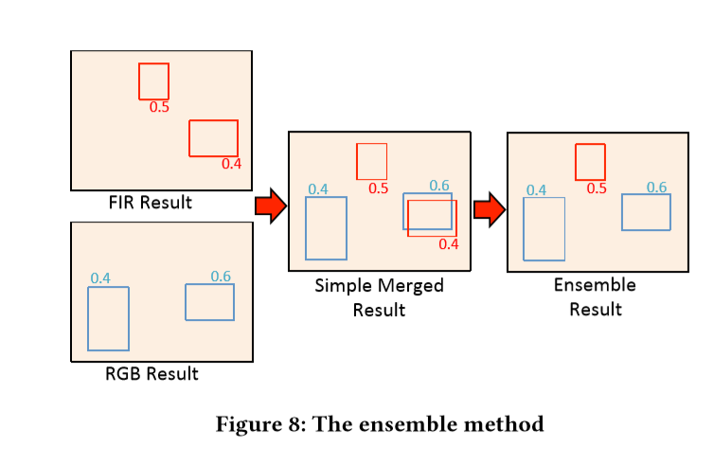
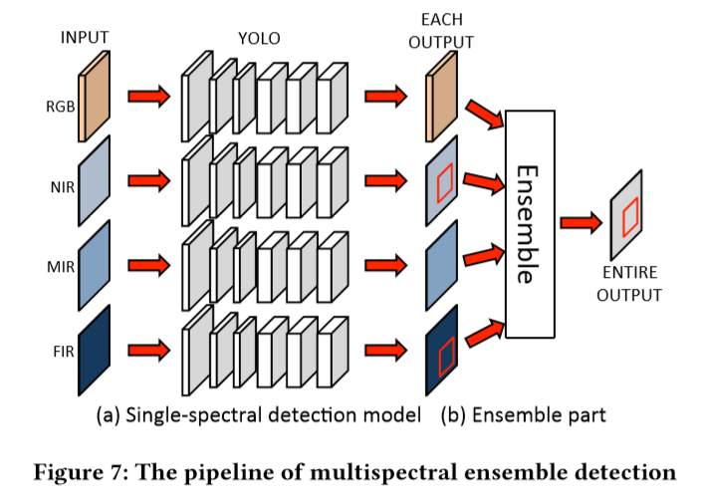
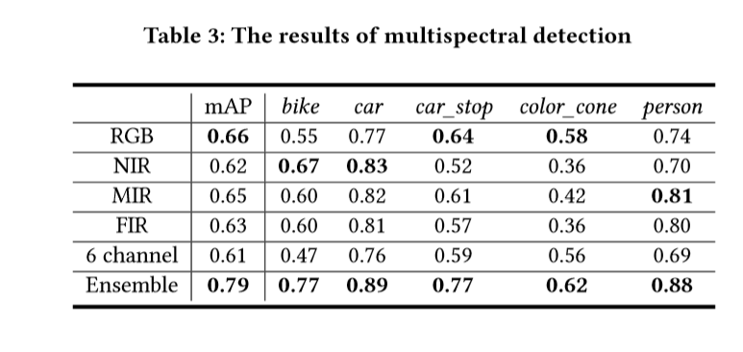
Takumi K , Watanabe K , Ha Q , et al. [ACM Press the - Mountain View, California, USA (2017.10.23-2017.10.27)] Proceedings of the on Thematic Workshops of ACM Multimedia 2017, - Thematic Workshops \"17 - Multispectral Object Detection for Autonomous Vehicles[C]// The. 2017:35-43.

Slide 5
方法 | Half fusion |  | rpn fusion |  | nms fusion
 | Roi pooling | Roi align | Roi pooling | Roi align
All | 40.44% | 36.78% | 40.26% | 34.17% | 41.96%
Day | 40.61% | 38.33% | 41.48% | 34.62% | 44.47%
Night | 40.62% | 34.00% | 37.61% | 32.32% | 36.63%
方法 | Nms fusion | Rgb | Ir
 |  | Roi pooling | Roi aglin
All | 41.96% | 49.09% | 46.04%
Day | 44.47% | 55.47%. | 50.33%
Night | 36.63% | 62.09% | 33.92%

Slide 6
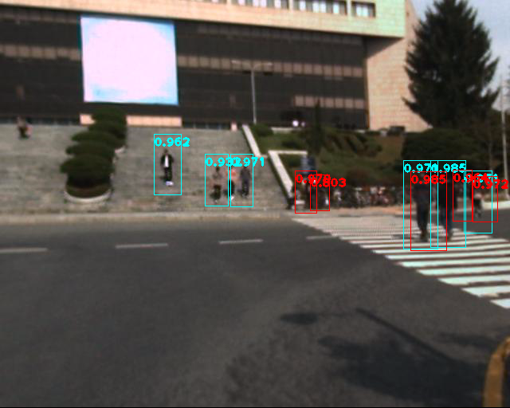
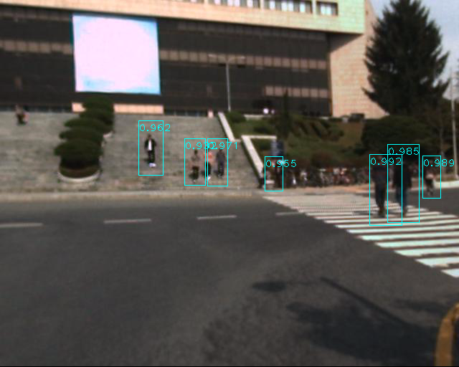

Slide 7
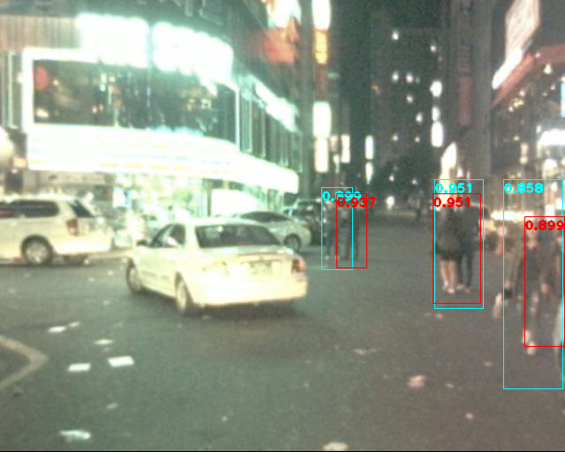
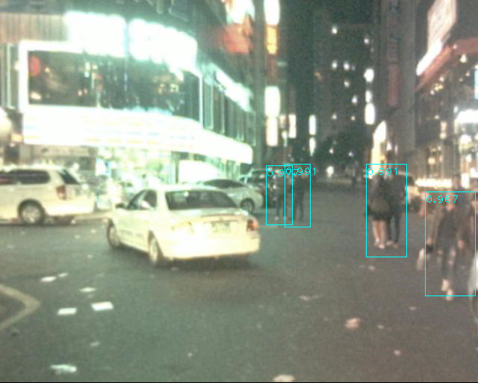

Slide 8
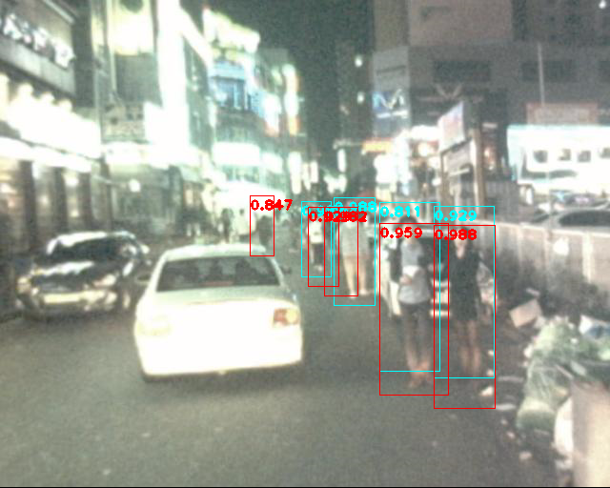
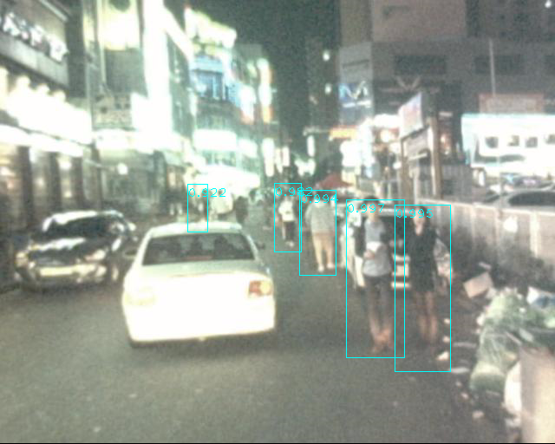

Slide 9
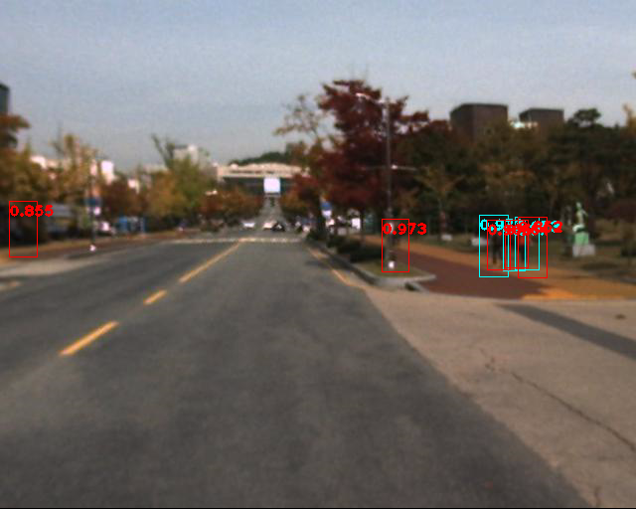
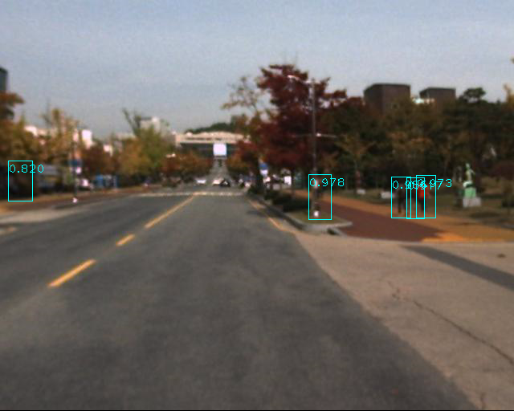

Slide 10
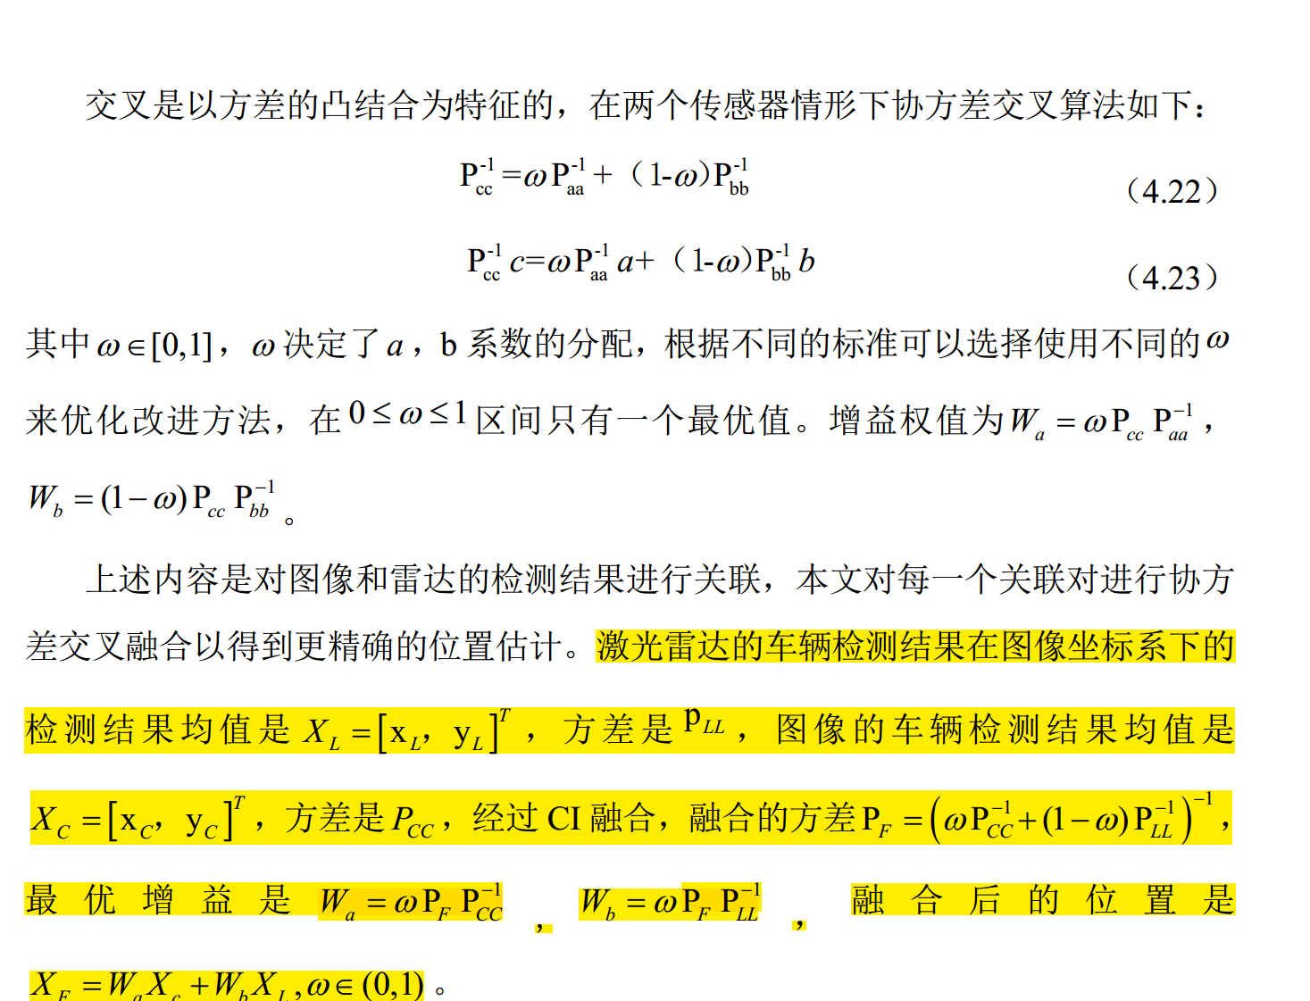
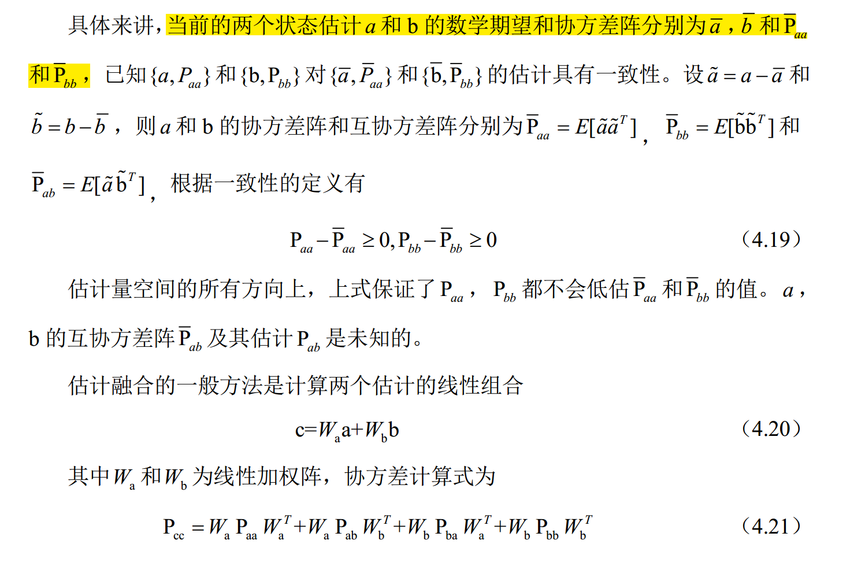
1，一致点漂移关联
2，协方差交叉融合

Slide 11
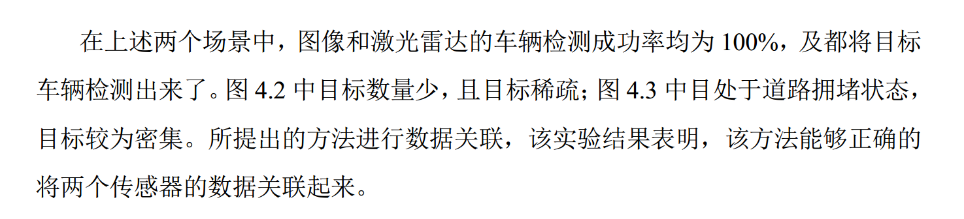
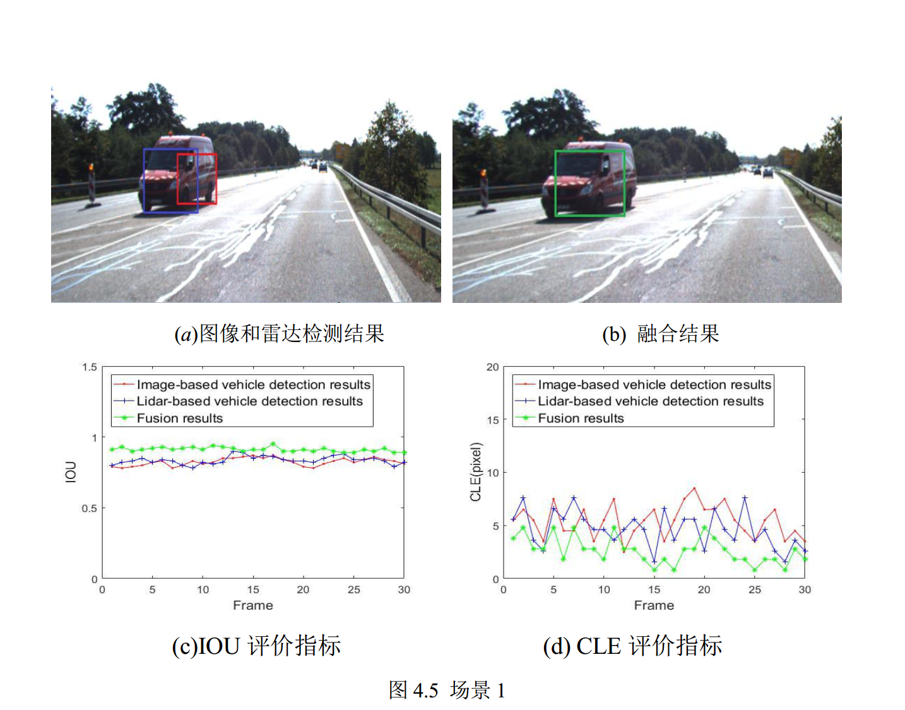
作者是两个传感器都检出了目标，但是都不精确，目的是通过协方差融合进行位置精修。

Slide 12
RPN FUSION
ROI align origin annotation improved annotation
Reasonable-all log-average miss rate = 34.17% (19.17%) recall = 87.85% (91.68%)
Reasonable-day log-average miss rate = 34.62% (43.28%) recall = 88.07% (63.02%)
Reasonable-night log-average miss rate = 32.32% (99.90%) recall = 87.31% (0.21%)
ROI pooling
Reasonable-all log-average miss rate = 40.26% (27.90%) recall = 83.40% (86.87%)
Reasonable-day log-average miss rate = 41.48% (49.77%) recall = 83.73% (59.45%)
Reasonable-night log-average miss rate = 37.61% (99.95%) recall = 82.59% (0.14%)
HALF FUSION
ROI pooling
Reasonable-all log-average miss rate = 40.44% (28.11%) recall = 80.79% (84.67%)
Reasonable-day log-average miss rate = 40.62% (49.82%) recall = 81.56% (58.28%)
Reasonable-night log-average miss rate = 40.61% (99.95%) recall = 78.86% (0.14%)
ROI align
Reasonable-all log-average miss rate = 36.78% (22.91%) recall = 83.90% (88.04%)
Reasonable-day log-average miss rate = 38.33% (46.72%) recall = 83.63% (60.00%)
Reasonable-night log-average miss rate = 34.00% (99.93%) recall = 84.58% (0.27%)

